Slide 1

“To Explore and Visualize the Data”
Aakesh Kunwar
Software Developer and Data Analyst

Slide 2

Unlock insights on any data
Power BI overview
Turning data into a business advantage

Slide 3








The world of data is changing
10x increase every five years
Big
Data
Consumerization of IT
4.3 connected devices per adult
85% from new data types
27%
using social media input

Slide 4



A powerful new way to work with data
Self-service business intelligence and analytics and the power of the cloud
Analyze in Excel, SQL db, Azure
1 Billion Office Users
Collaborate in Power BI for Office 365
1 in 4 enterprise customers on Office 365
Collaborate in Power BI for Office 365
1 in 4 enterprise customers on Office 365
Discover
Analyze
Visualize
Share
Question
Mobility
Share
Question
Mobility
Q&A
Q&A
Scalable | Manageable | Trusted

Slide 5
REPORTS
DATA SOURCES
DASHBOARDS
DEVICES
+
VISUALIZATIONS

Slide 6
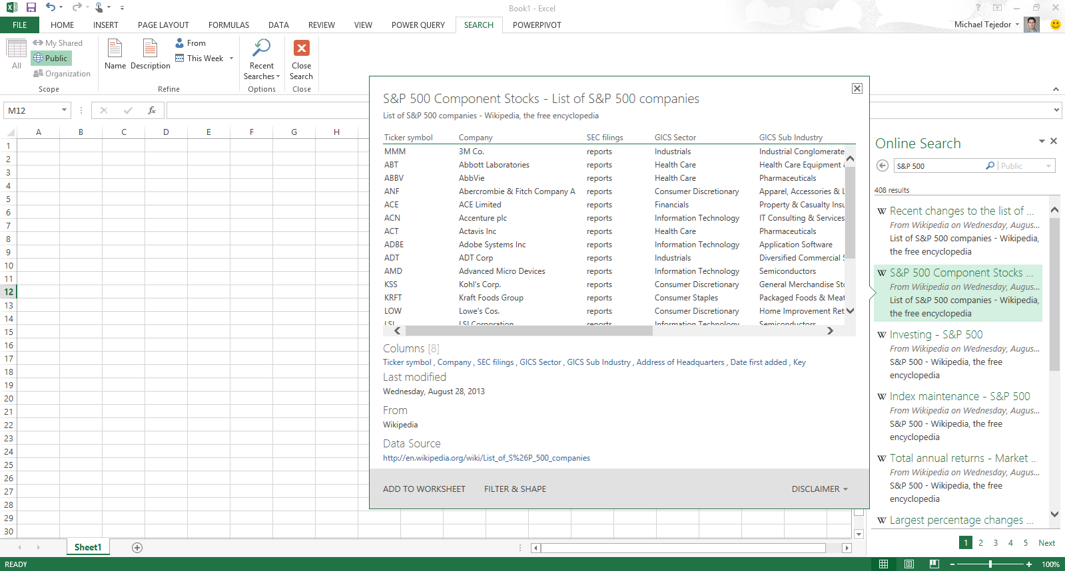
Analyzing data with Excel
Easily discover and access public and corporate data
Discover
Analyze
Visualize
Explore

Slide 7
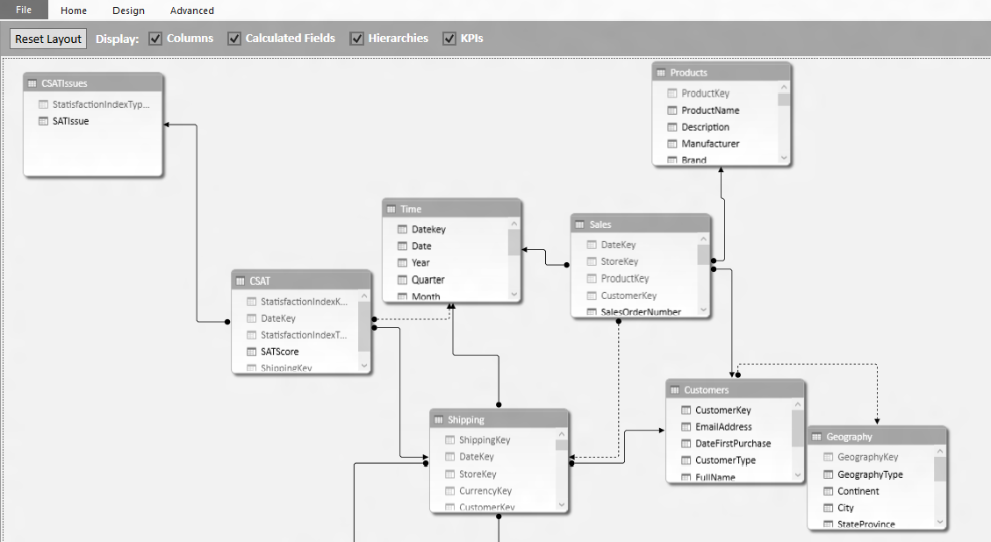
Analyzing data with Excel
Model & analyze 100’s of millions of rows of data
Discover
Analyze
Visualize
Explore

Slide 8
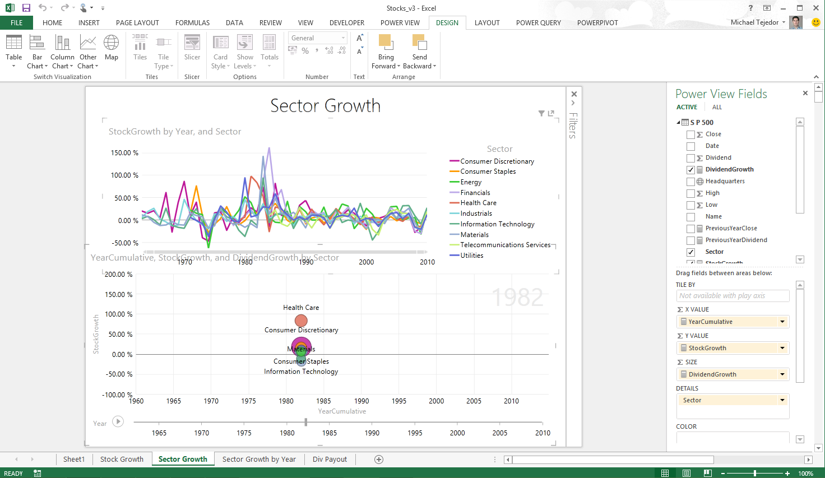
Analyzing data with Excel
Explore your data with interactive visualization
Discover
Analyze
Visualize
Explore

Slide 9
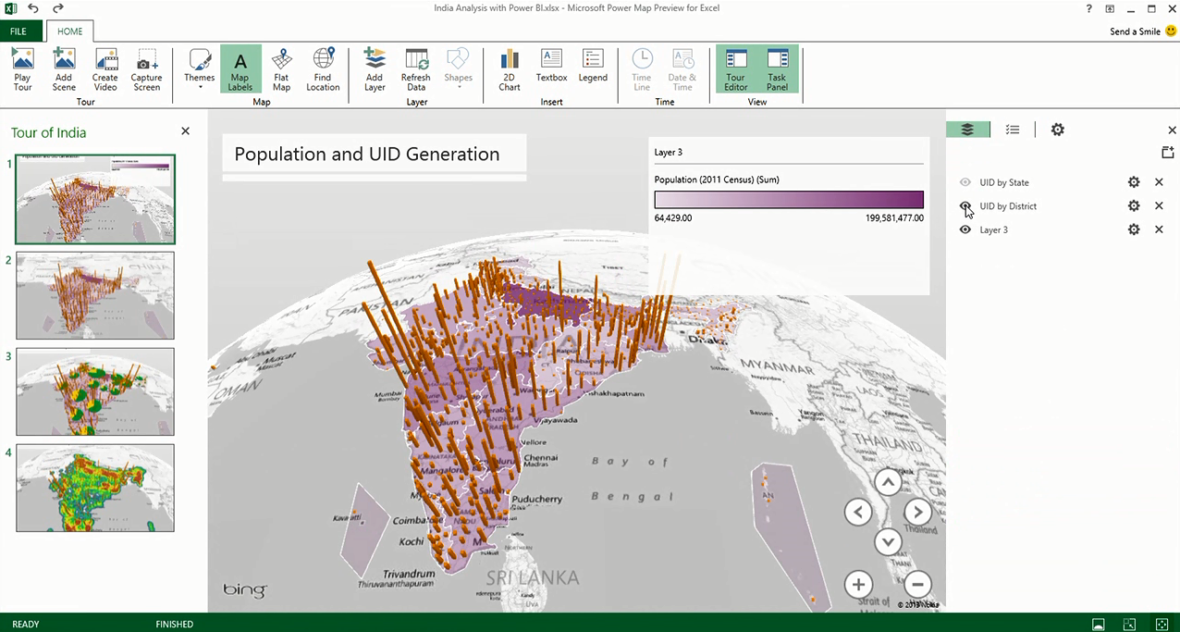
Analyzing data with Excel
Uncover new insights with 3D geospatial analysis
Discover
Analyze
Visualize
Explore

Slide 10
Power BI Service Integration
DEVELOPER
AZURE
SUBSCRIPTION
AZURE
DATA
WORKSPACES
WORKSPACE
APP
APP

Slide 11
Demo

